Slide 1


BRUNO RODRÍGUEZ
Company Valuation
PROYECT PROPOSAL

Slide 2


CONTENT
01
INTRODUCCIÓN
02
WHO AM I
03
VALUATION PROCESS
04
EXAMPLE
05
AI RESULTS
06
CONCLUSION

Slide 3

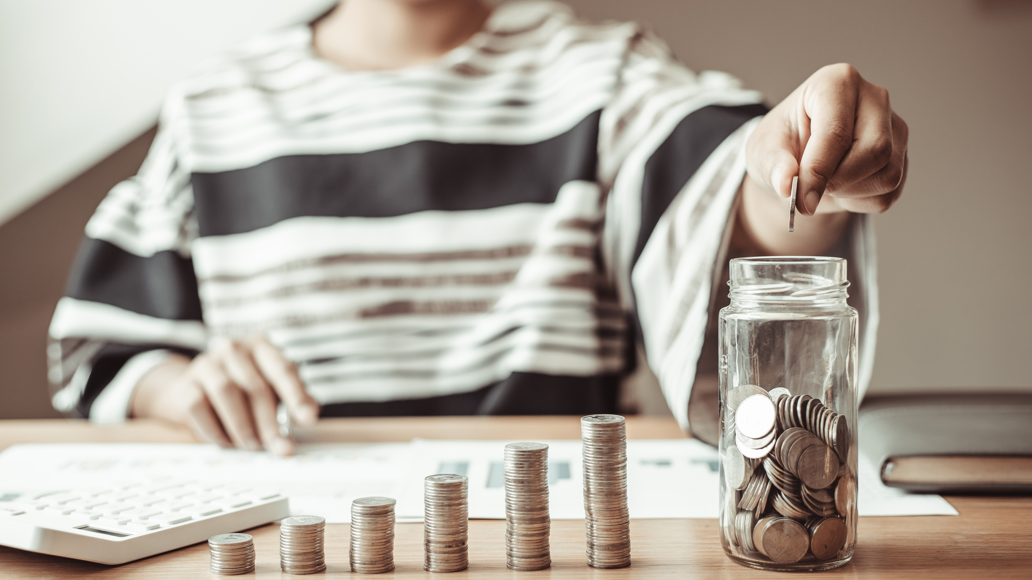
BRUNO RODRÍGUEZ
INTRODUCTION
The idea is to solve or facilitate the process of company valuation for retail investors.
This includes understanding reports and analyzing financial statements.

Slide 4



BRUNO RODRÍGUEZ
WHO
AM I
My name is Bruno Rodriguez, and I have been working in the logistics sector, as a warehouse worker.
Inflation causes our savings to lose value.
An inflation of 2% in 20 years causes the money we have saved to lose about 33% of its value. To maintain the same purchasing power, our money must revaluate up to 50% approx.
Investing is the way we can protect our savings from inflation.

Slide 5




VALUATION
BRUNO RODRÍGUEZ
PROCESS
NotebookLM
Excel
TEXT ANALYSIS
VALUATION
PowerBI
AI
DATA VISUALIZATION
PREDICTIONS

Slide 6
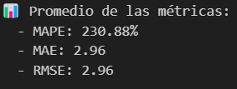
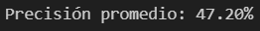

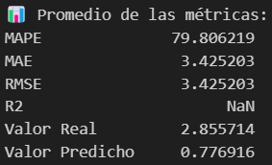
AI
EMPRESA ENSIGNA
RESULTS
AVERAGE
XGBOOST
(Random Forest)
ARIMA
(Time Series)
KERAS
(Neaural Networks)

Slide 7

BRUNO RODRÍGUEZ
CONCLUSION
These tools are expected to facilitate the process of company valuation, although the visualizations can be further embellished and AI predictions can be further explored.
In any case, the visualizations shed light on trends in very important metrics and a first step has been taken in trying to gain an AI advantage in this project.
Thank you very much.

